Slide 1

B.Tech Project External Evaluation, VIIIth Sem SOPA: A Parking Solution
Presented by:
Kumar Anurag, 2018006817
Rahul Singh, 2018009434
Nandita Pokhriyal, 2018013001
Akshat Gupta, 2018011084
Mohd. Shahnawaz, 2018012249
Sonal Shriti, 2018004874
Under the Supervision of:-
Dr Vishal Jain
Sharda University, Gr. Noida
DEPARTMENT OF COMPUTER SCIENCE & ENGINEERING
SCHOOL OF ENGINEERING AND TECHNOLOGY
May 2022
‹#›

Slide 2
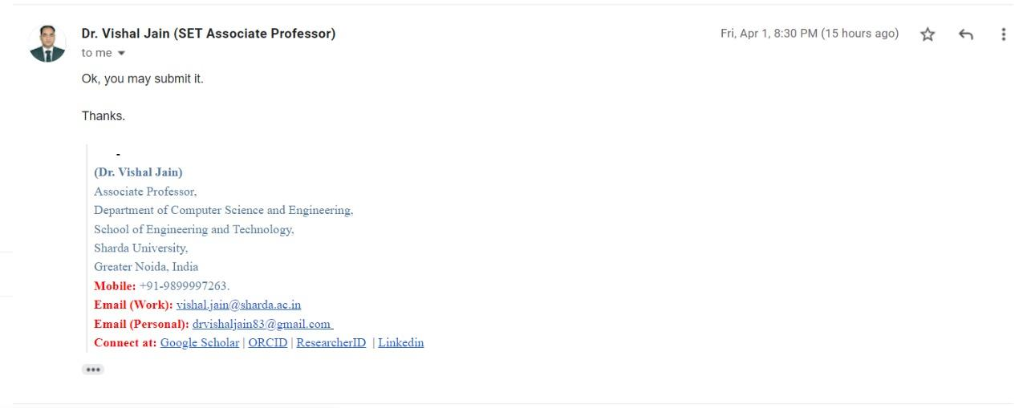
Approval from guide for the evaluation

Slide 3
Contents
1.Project Overview
1.1 Problem Statement
1.2 Proposed Solution
1.3 UML Diagrams
1.4 DFDs
1.5 Free users and Premium users
1.6 Case Studies
1.7 App Blueprint
2. Roles and Responsibilities
3. Work Done
4. Proof of paper accepted or communicated/ Hackathon/ Patent

Slide 4
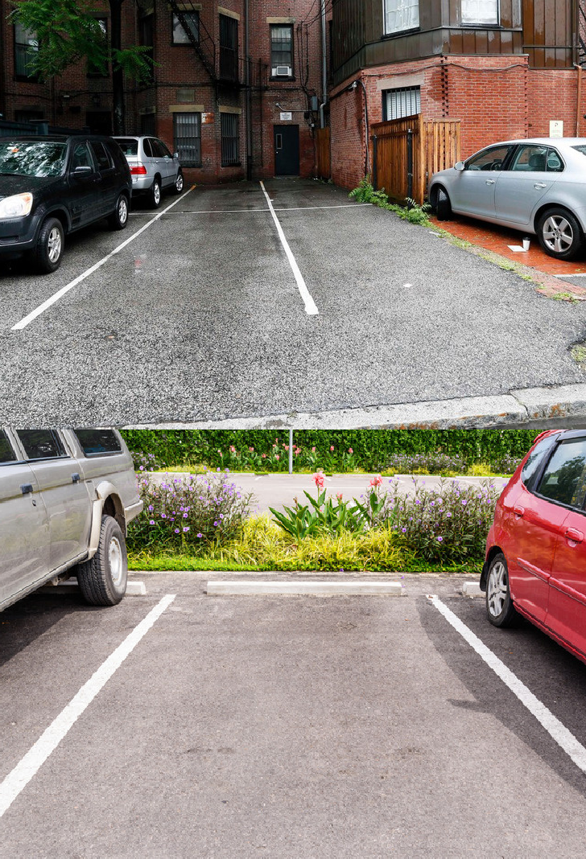
SOPA
A PARKING SOLUTION

Slide 5
Problem Statement
Commuters face a problem where they struggle and spend their precious time looking for parking spots.
Also a number of people have unused private parking space which can be utilised.
There is a major lack of parking space data for app (need refinement ideas).

Slide 6
Proposed Solution
We present a new approach to solve this problem by using an app that relies on crowdsourced data to provide users with parking options wherever they go.
This brings up another problem of providing users with an incentive to contribute to the data collection process, which we elegantly solve by bringing in new features to incentify that process, such as a reward system.
Authenticity of the marked data is calculated through the review system.
We also present a way to tackle the problem of parking spot availability by providing users with options to lease their private parking spots.

Slide 7
UML DIAGRAMS
USE CASE DIAGRAM, CLASS DIAGRAM, SEQUENCE DIAGRAM

Slide 8
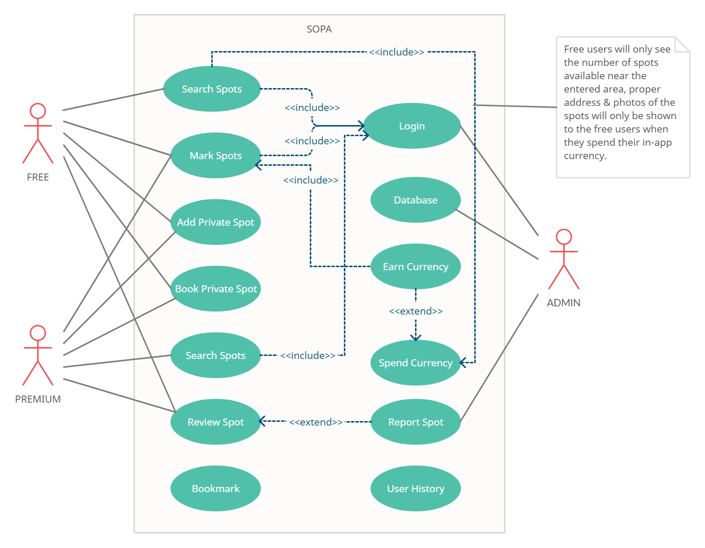
USE-CASE

Slide 9
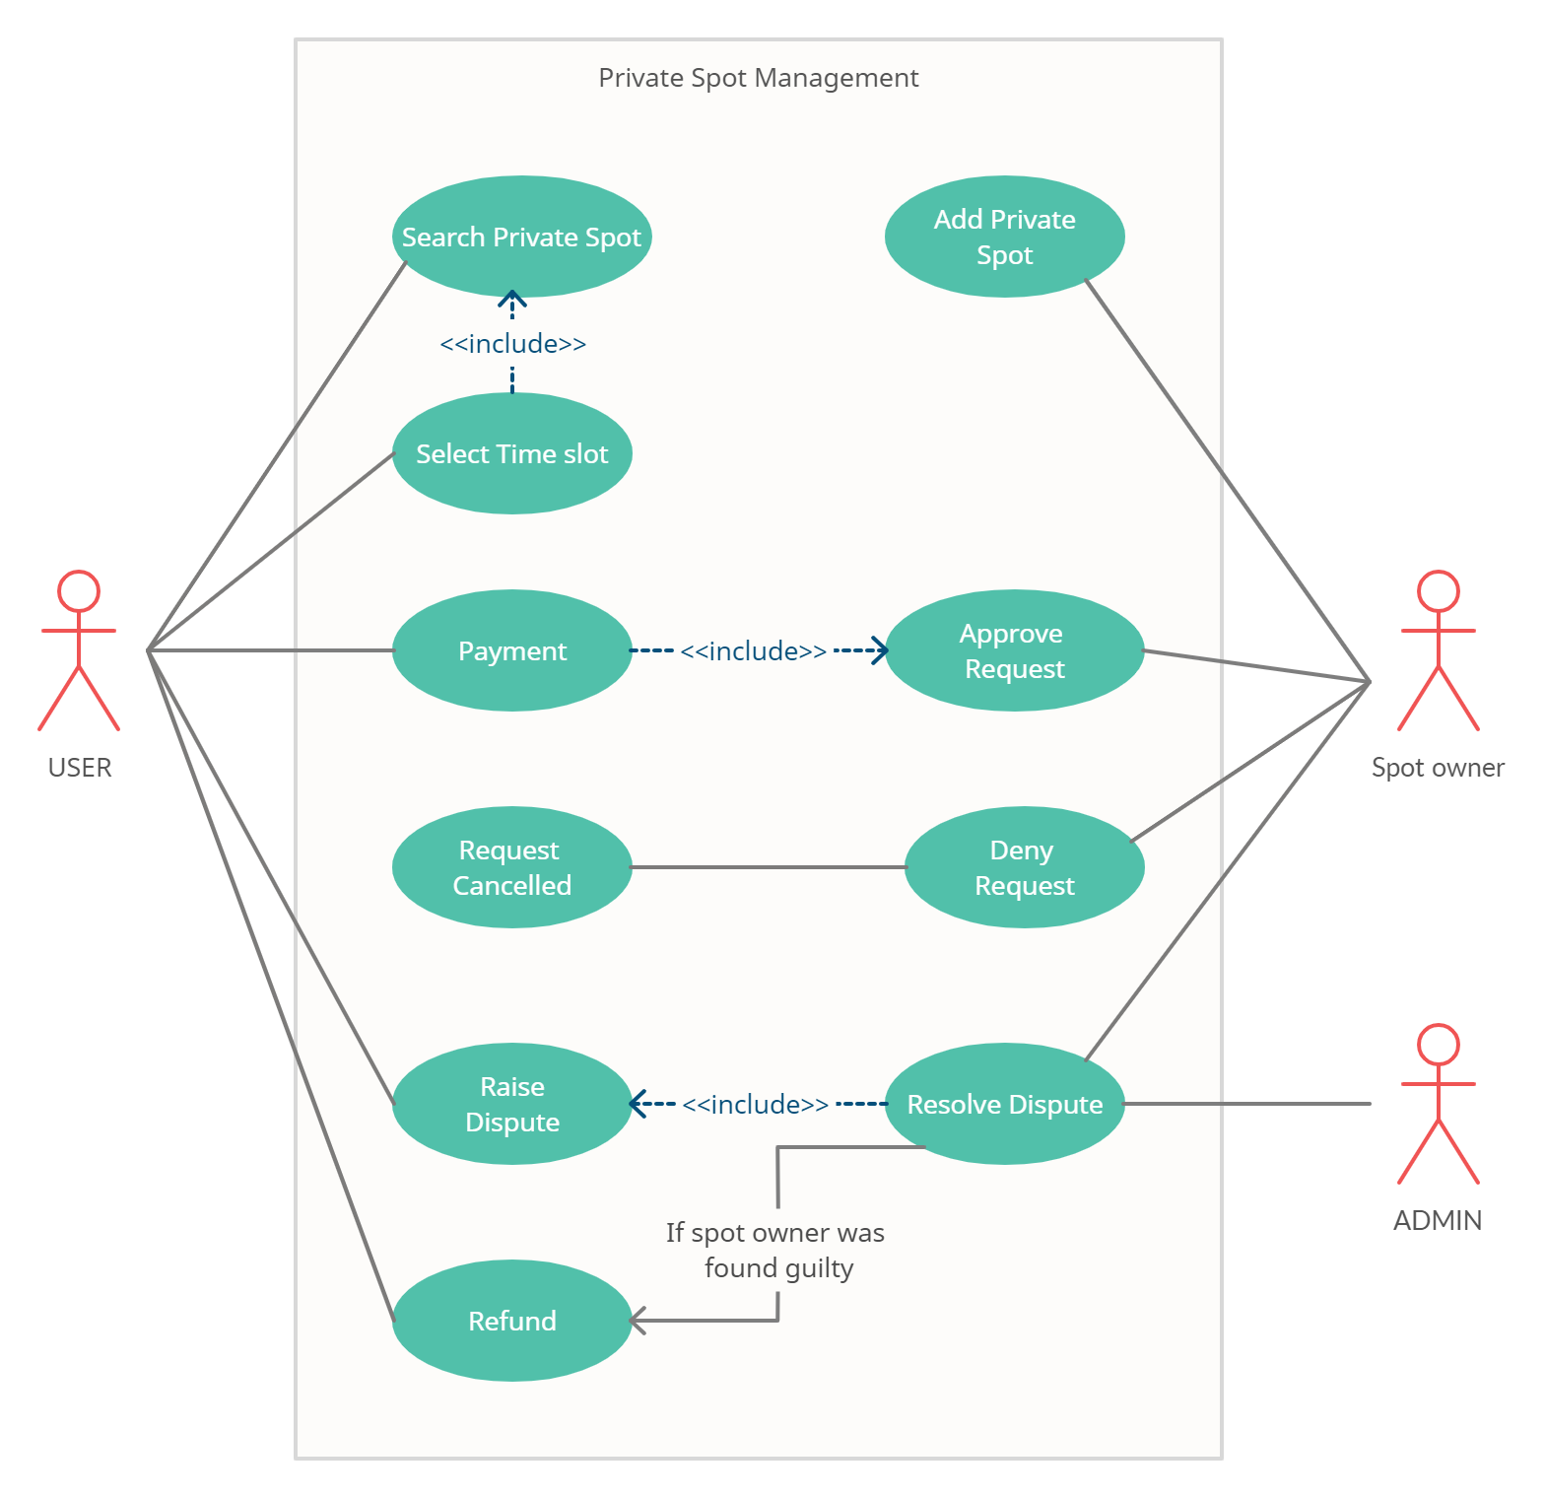
USE-CASE 2

Slide 10
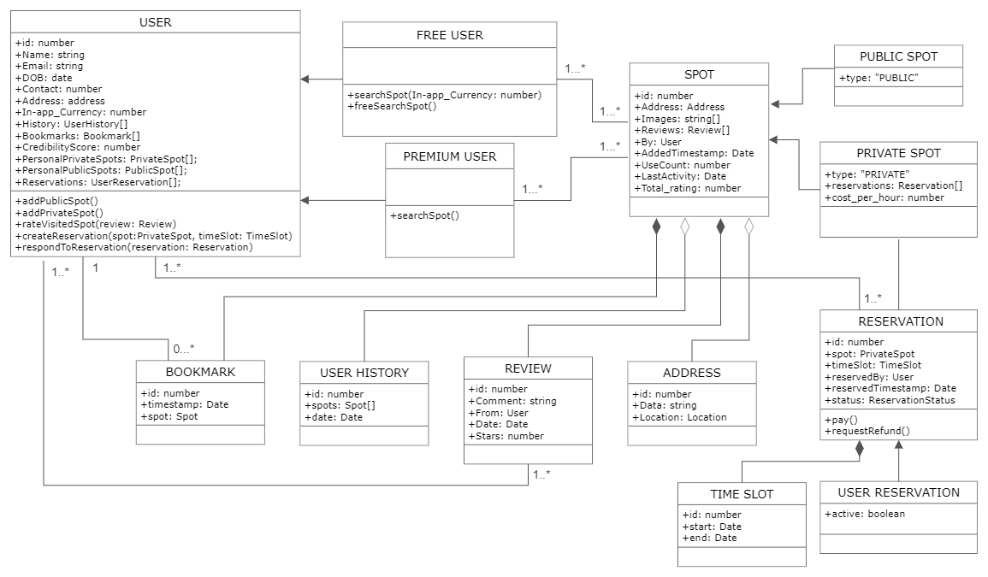
CLASS DIAGRAM

Slide 11
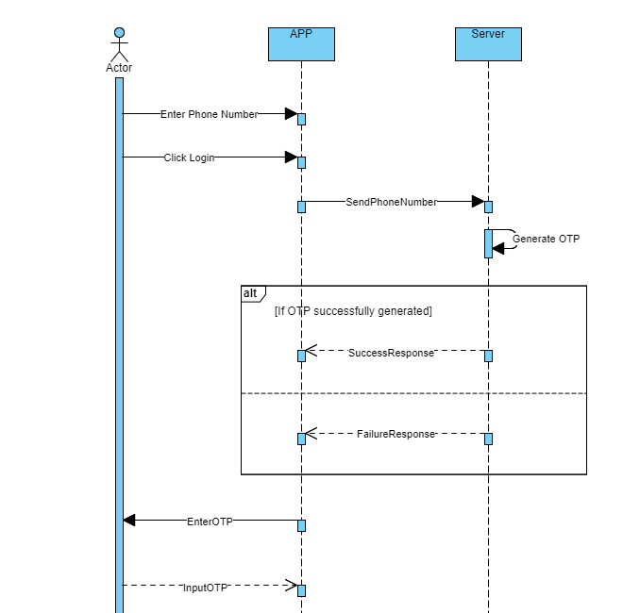
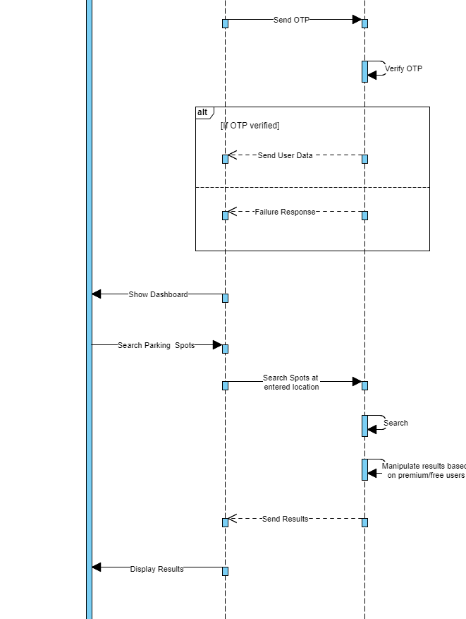
SEQUENCE DIAGRAM
(For login and searching spots)

Slide 12
DFDs
0 level, 1 level, 2 level

Slide 13
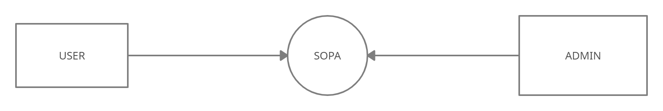
Level-0
DFD

Slide 14
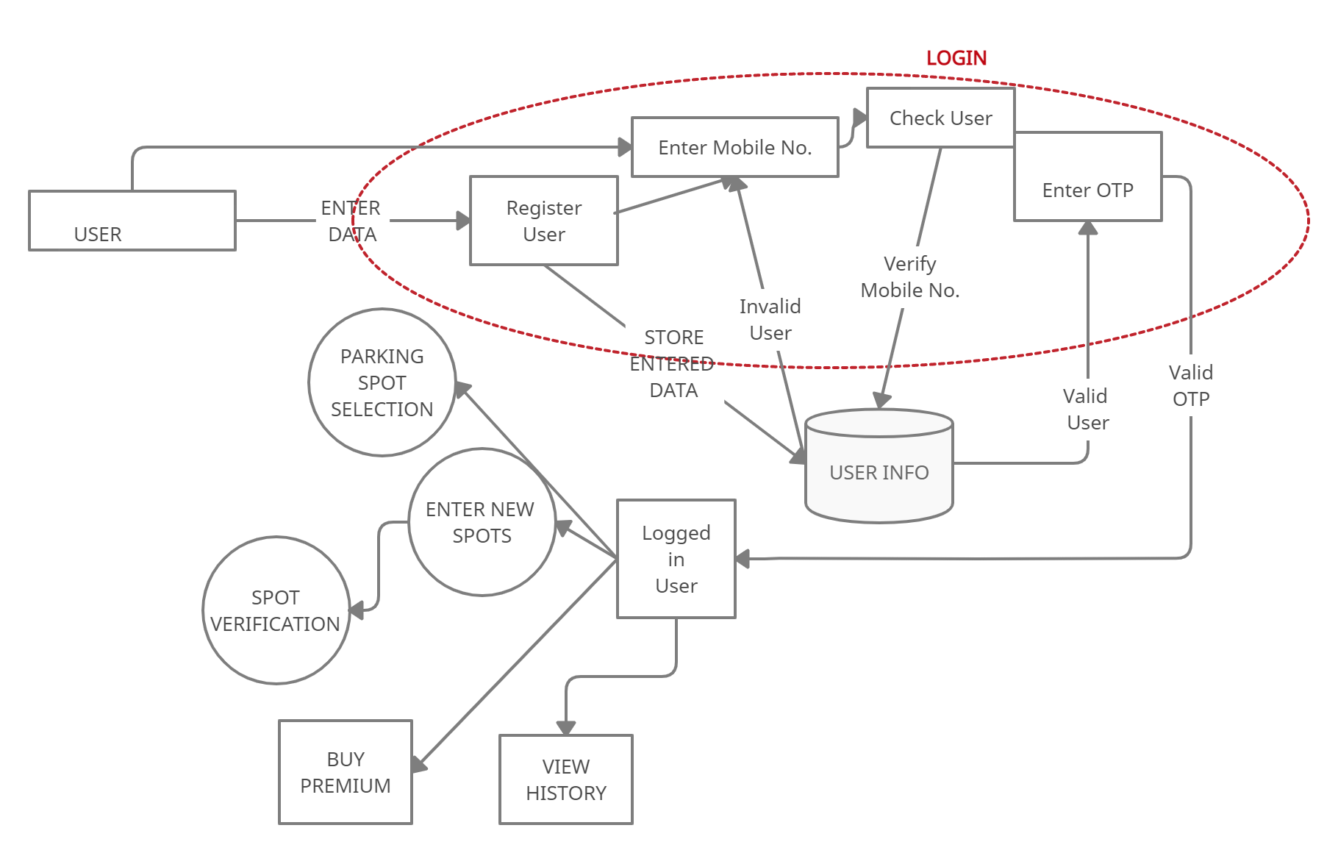
Level-1
DFD

Slide 15
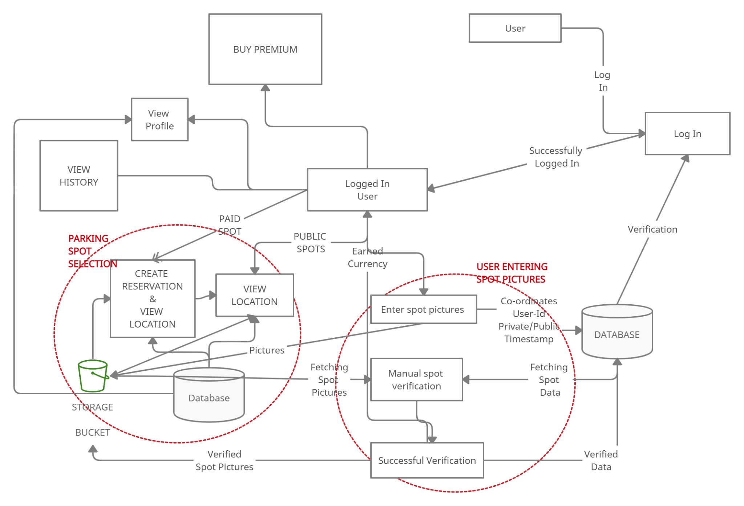
Level-2
DFD

Slide 16
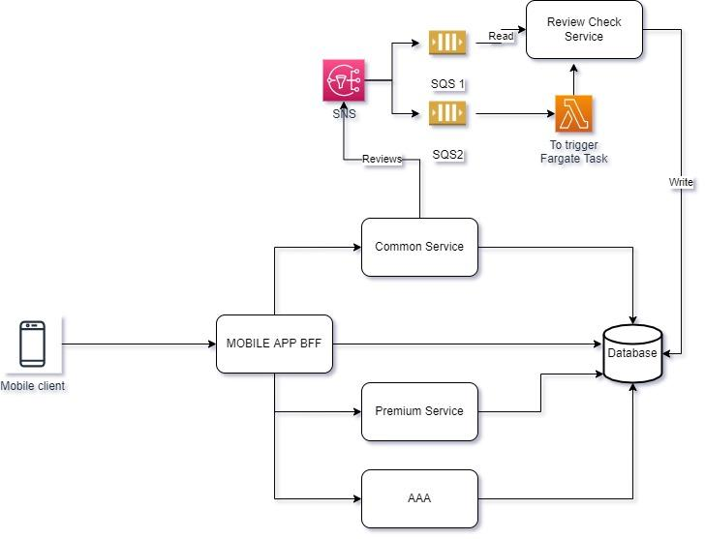
System
Architecture

Slide 17
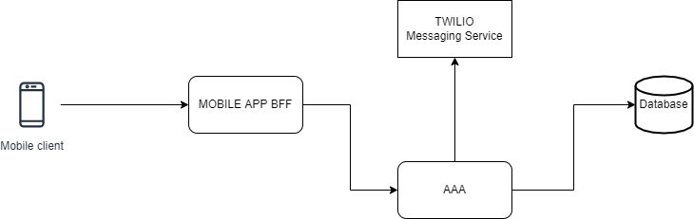
Authentication
System
Design

Slide 18
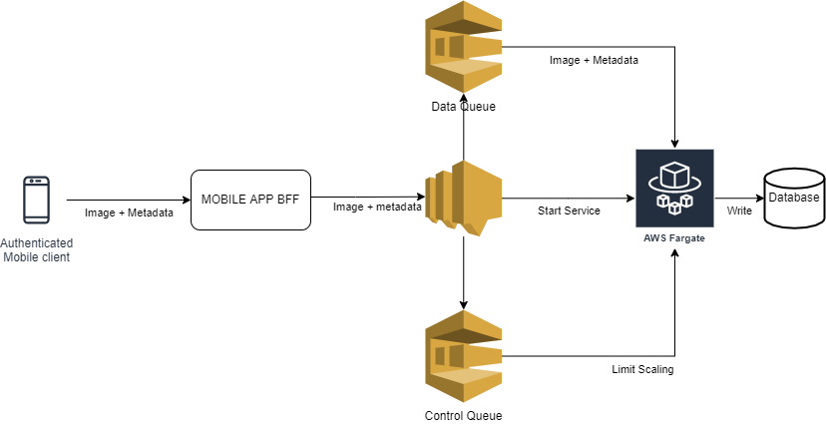
Add a Spot
Architecture

Slide 19
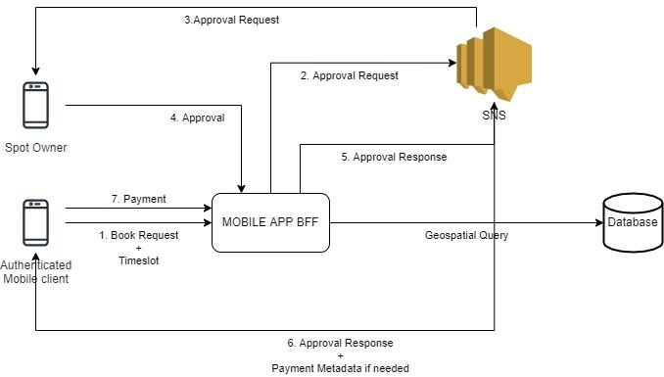
Rent a Spot
Architecture

Slide 20
Users
Free, Premium

Slide 21
Free User
Premium User
Can Add Parking Locations to earn Karma.
Can do a free search without spending karma which results in mediocre experience.
Can do a detailed search by spending karma which results in superior experience.
Can lease a private spot.
Can reserve a private spot.
Can review and rate spots.
Can Add Parking Locations to earn Karma.
Does not need to spend karma. Can save it for later.
Can do a detailed search without having to spend karma which results in superior experience.
Can lease a private spot.
Can reserve a private spot.
Can review and rate spots.

Slide 22
Case Studies

Slide 23
Parking Rhino | Best Parking | Park Plus

Slide 24
S. No | Features | Parking Rhino | Best Parking | Park Plus | SOPA (our solution)
1. | Review/ Report | ✔ | ✔ | ✔ | ✔
2. | Location Search | ✔ | ✔ | ✔ | ✔
3. | Location wide slot display | ✔ | ✔ | ✔ | ✔
4. | Free Parking Options | ✔ |  |  | ✔
5. | Pay and park Options | ✔ | ✔ | ✔ | ✔
6. | Premium |  |  |  | ✔
7. | Easy Payments | ✔ | ✔ | ✔ | ✔
8. | Refund |  |  |  | ✔
9. | In-app Currency |  |  |  | ✔
10. | Add Parking Spots |  | ✔ | ✔ | ✔
11. | Spot Reservation |  | ✔ |  | ✔(private spots)
12. | Distinct Markers | ✔ |  |  | ✔
13. | Real-time Navigation | ✔ | ✔ | ✔ | ✔
14. | Detailed Location Information | ✔ | ✔ | ✔ | ✔
15. | Lease Out a spot |  |  |  | ✔

Slide 25
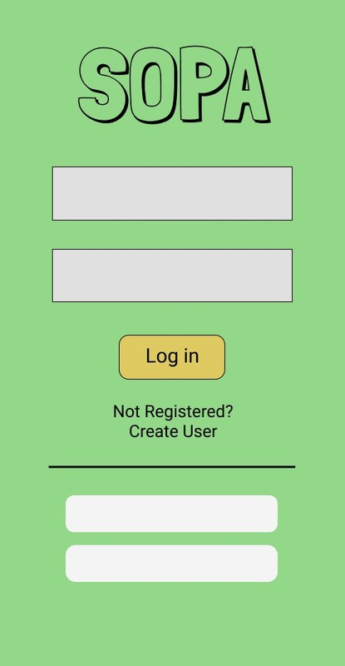
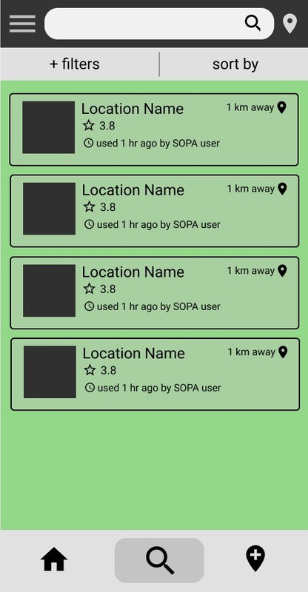
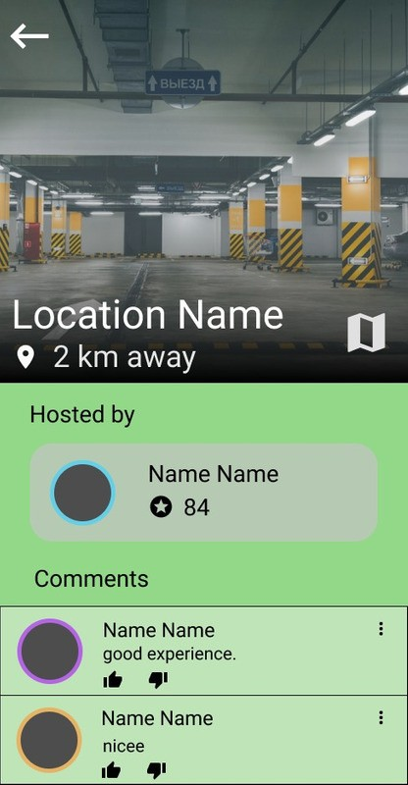
APP BLUEPRINT

Slide 26
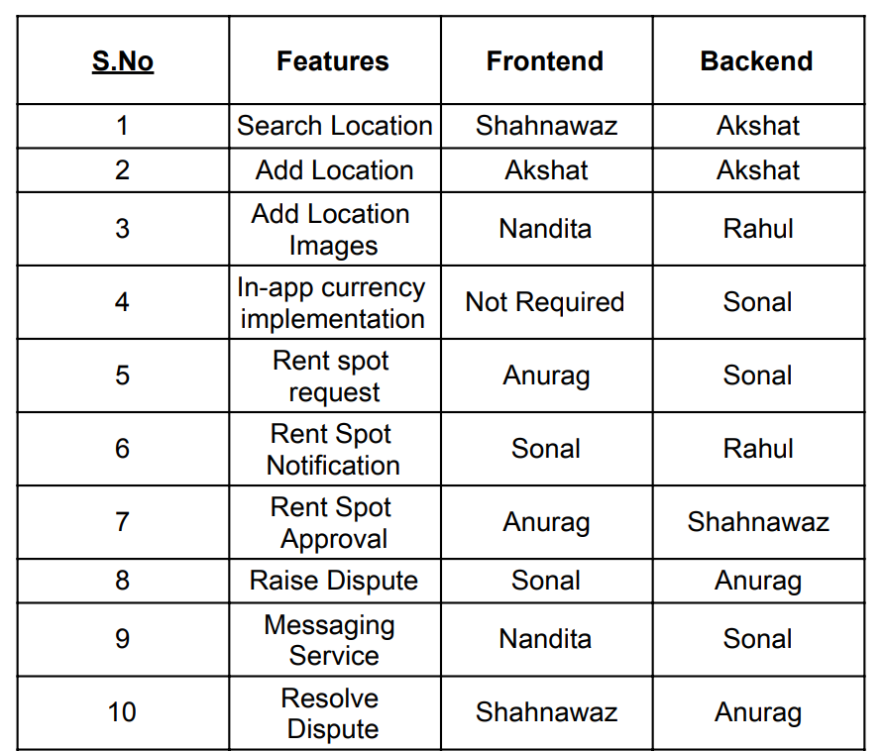
Roles & Responsibilities

Slide 27
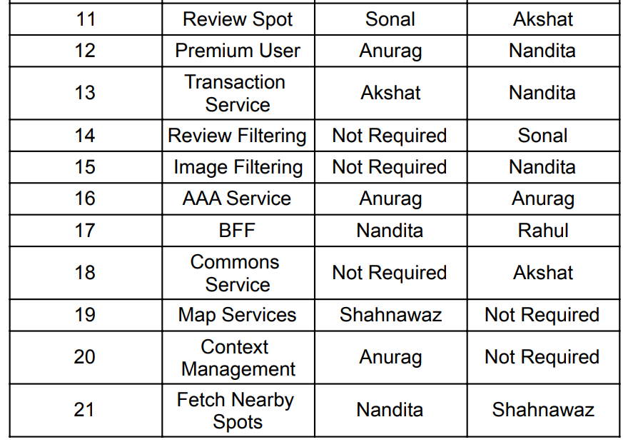
Continued

Slide 28
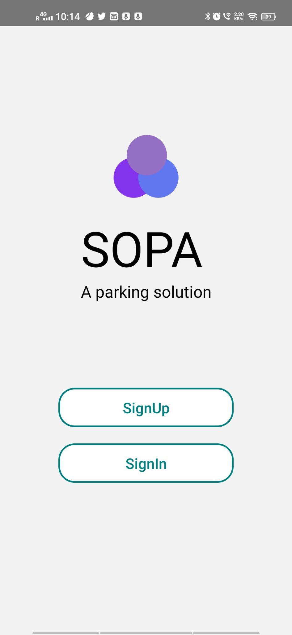
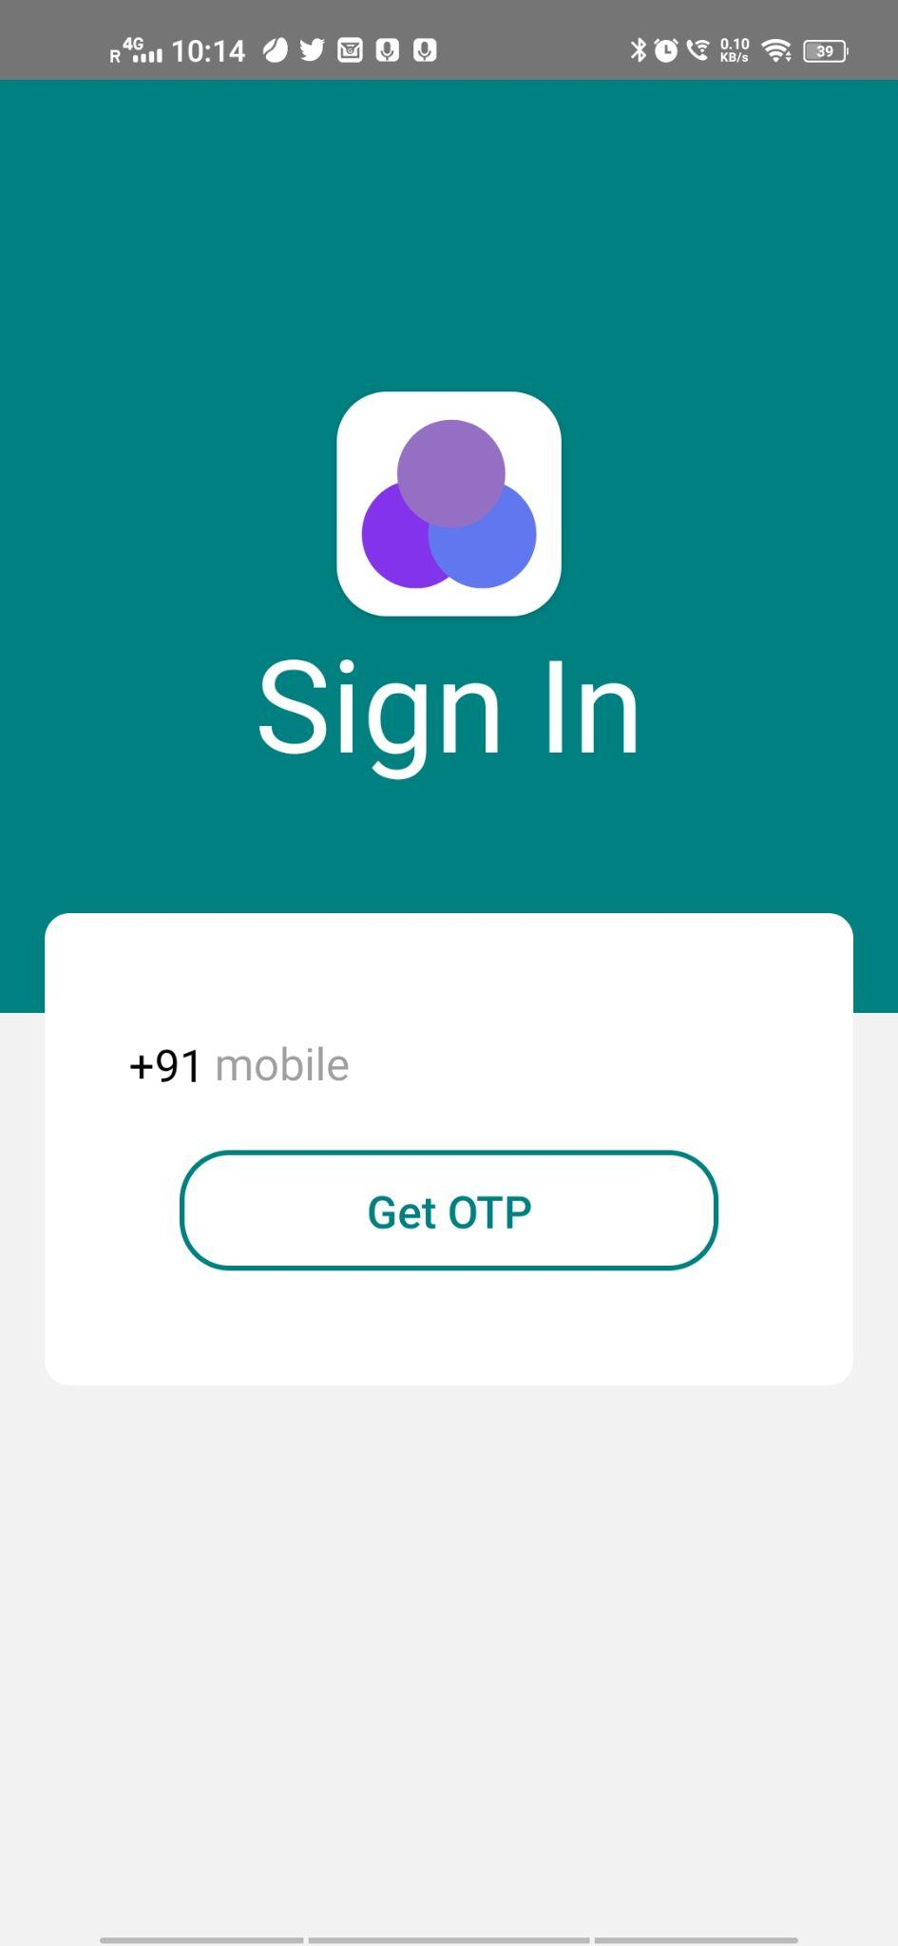
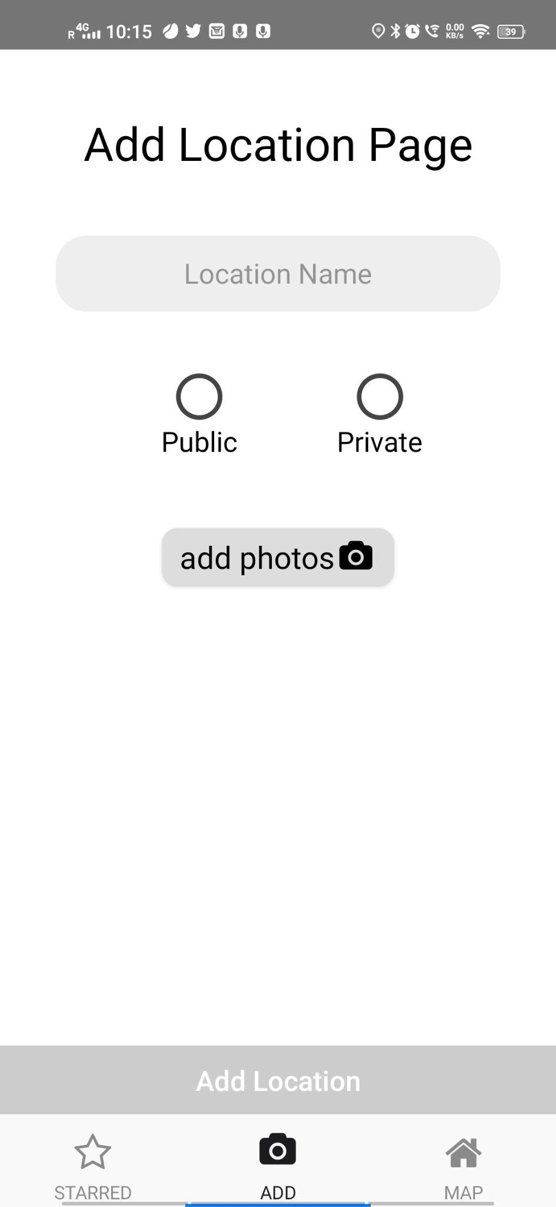
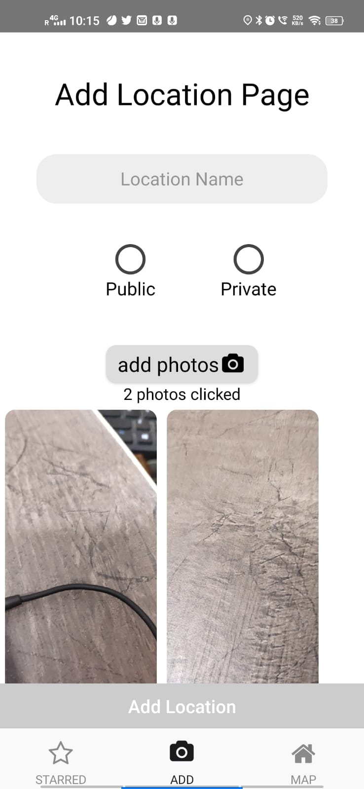
Work Done
Sign Up and Sign In
Sign in with OTP
Adding public and private parking spots

Slide 29
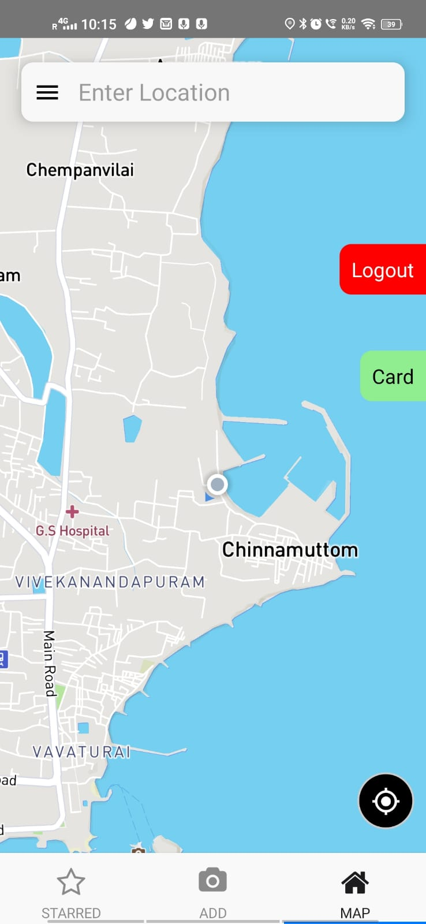
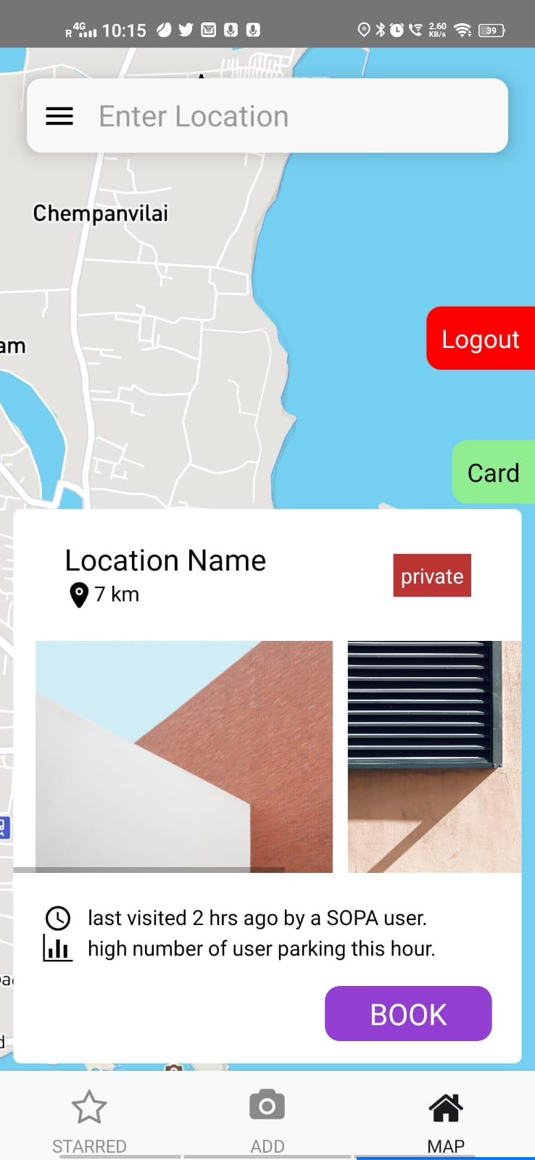
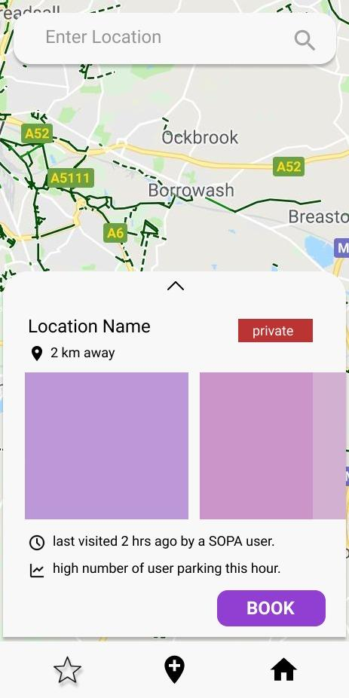
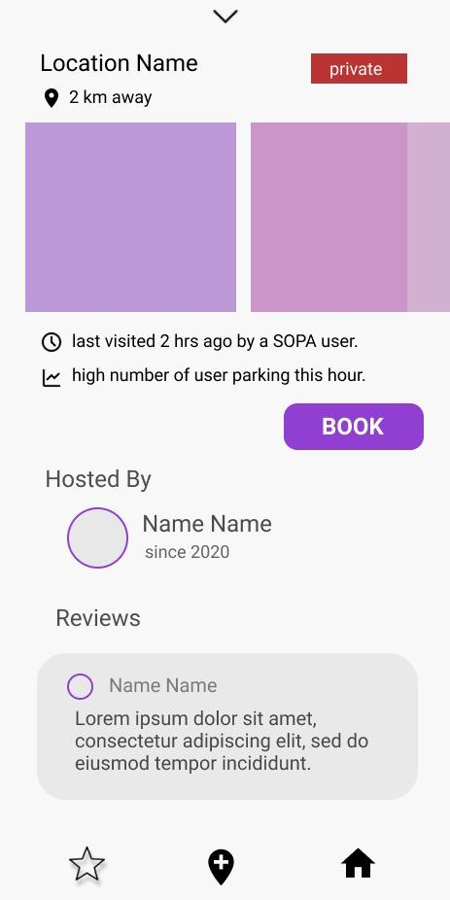
Searching for parking spots based on location

Slide 30
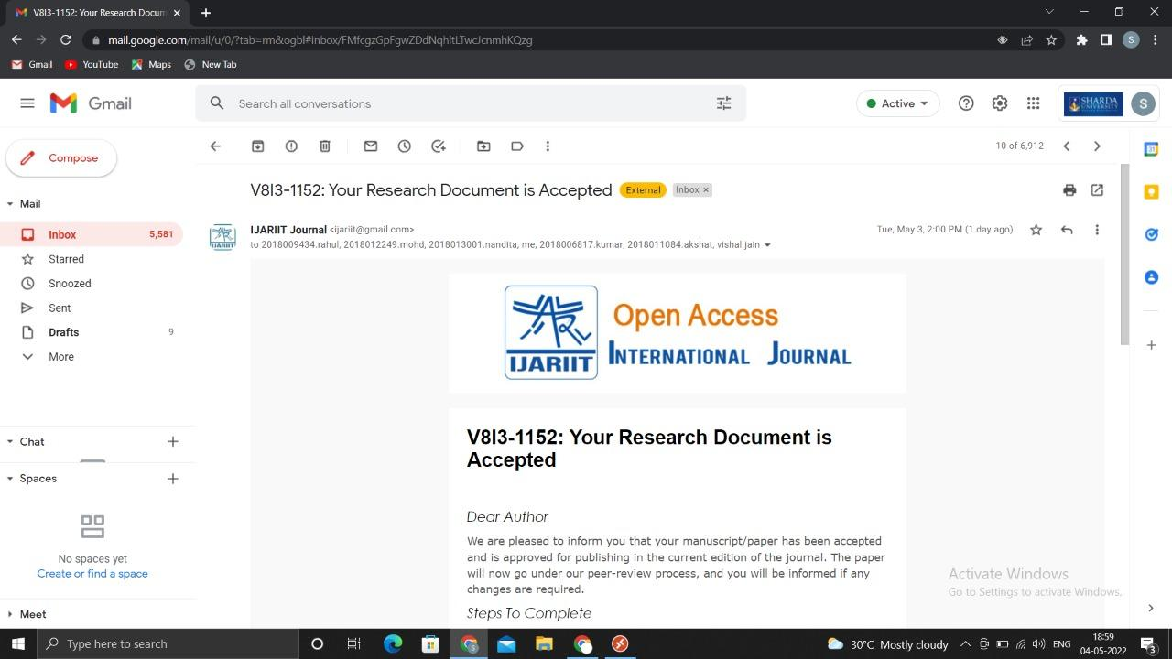
Outcome
https://www.ijariit.com/manuscript/sopa-a-parking-solution/

Slide 31
References/ Bibliography
Parking Rhino
Best Parking
Park Plus
Arrive Solutions
Case Study Links
Best Parking
Parking Rhino
Park Plus

Slide 32
Diagram Links
https://drive.google.com/drive/folders/1MR4AvaD_c-FKydTXkNxsIxh1b9sn3Bly
https://drive.google.com/drive/folders/1MR4AvaD_c-FKydTXkNxsIxh1b9sn3Bly
https://drive.google.com/drive/folders/1MR4AvaD_c-FKydTXkNxsIxh1b9sn3Bly
https://drive.google.com/drive/folders/1MR4AvaD_c-FKydTXkNxsIxh1b9sn3Bly
https://drive.google.com/drive/folders/1MR4AvaD_c-FKydTXkNxsIxh1b9sn3Bly
https://drive.google.com/drive/folders/1MR4AvaD_c-FKydTXkNxsIxh1b9sn3Bly
https://drive.google.com/drive/folders/1MR4AvaD_c-FKydTXkNxsIxh1b9sn3Bly

